Slide 1
Artificial intelligence
Autumn 2008
Instructor: Wang Xiaolong
Harbin Institute of Technology, Shenzhen Graduate School
Intelligent Computation Research Center
(ICRC)

Slide 2
X. Knowledge representation
Autumn 2008
Instructor: Wang Xiaolong
Harbin Institute of Technology, Shenzhen Graduate School
Intelligent Computation Research Center
(ICRC)

Slide 3
Outline
Ontological engineering
Categories and objects
Actions, situations and events
Mental events and mental objects
The internet shopping world
Reasoning systems for categories
Reasoning with default information
Truth maintenance systems

Slide 4
Ontological engineering
How to create more general and flexible representations.
  Concepts like actions, time, physical object and beliefs
  O.E. operates on a bigger scale than K.E.
Define general framework of concepts
  Upper ontology
Limitations of logic representation
  Red, green and yellow tomatoes: exceptions and uncertainty
Notes:
K.E=Knowledge Engineering
Upper ontology=上位本体论

Slide 5
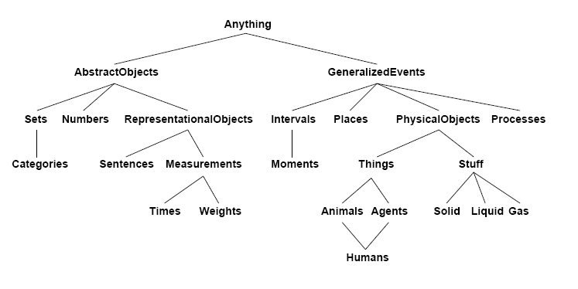
The upper ontology of the world

Slide 6
Difference with special-purpose ontologies
A general-purpose ontology should be applicable in more or less any special-purpose domain.
  Add domain-specific axioms
In any sufficiently demanding domain different areas of knowledge need to be unified.
  Reasoning and problem solving could involve several areas simultaneously
What do we need to express?
  Categories, Measures, Composite objects, Time, Space, Change, Events, Processes, Physical Objects, Substances, Mental Objects, Beliefs

Slide 7
Categories and objects
KR requires the organization of objects into categories
  Interaction with the world takes place at the level of the object
  Reasoning at the level of categories
Categories play a role in predictions about objects
  Based on perceived properties
Categories can be represented in two ways by FOL
  Predicates: apple(x)
  Reification of categories into objects: apples
Category = set of its members

Slide 8
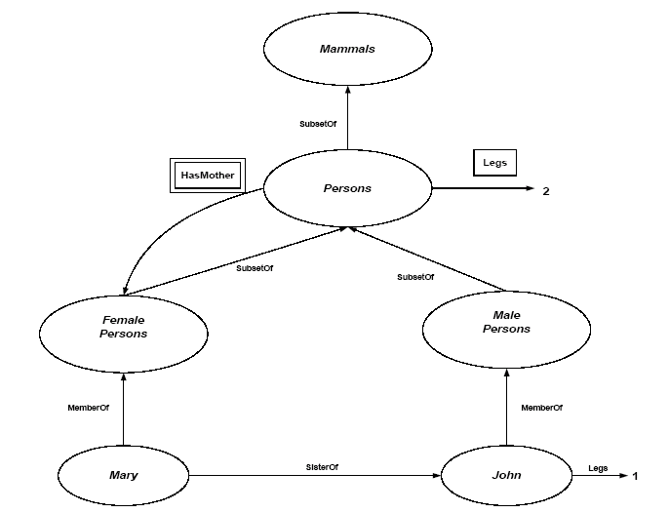
Category organization
Relation = inheritance:
  All instance of food are edible, fruit is a subclass of food and apples is a subclass of fruit then an apple is edible.
Defines a taxonomy

Slide 9
FOL and categories
An object is a member of a category
  MemberOf(BB₁₂,Basketballs)
A category is a subclass of another category
  SubsetOf(Basketballs,Balls)
All members of a category have some properties
  ∀ x (MemberOf(x,Basketballs) ⇒ Round(x))
All members of a category can be recognized by some properties
  ∀ x (Orange(x) ∧ Round(x) ∧ Diameter(x)=9.5in ∧ MemberOf(x,Balls) ⇒ MemberOf(x,BasketBalls))
A category as a whole has some properties
  MemberOf(Dogs,DomesticatedSpecies)
Notes:
DomesticatedSpecies=训化动物

Slide 10
Relations between categories
Two or more categories are disjoint if they have no members in common:
  Disjoint(s)⇔(∀ c₁,c₂ c₁ ∈ s ∧ c₂ ∈ s ∧ c₁ ≠ c₂ ⇒ Intersection(c₁,c₂) ={})
  Example; Disjoint({animals, vegetables})
A set of categories s constitutes an exhaustive decomposition of a category c if all members of the set c are covered by categories in s:
  E.D.(s,c) ⇔ (∀ i i ∈ c ⇔ ∃ c₂ c₂ ∈ s ∧ i ∈ c₂)
  Example: ExhaustiveDecomposition({Americans, Canadian, Mexicans},NorthAmericans).

Slide 11
Relations between categories
A partition is a disjoint exhaustive decomposition:
  Partition(s,c) ⇔ Disjoint(s) ∧ E.D.(s,c)
  Example: Partition({Males,Females}, Animals).
Is ({Americans,Canadian, Mexicans},NorthAmericans) a partition?
Categories can be defined by providing necessary and sufficient conditions for membership
  ∀ x Bachelor(x) ⇔ Male(x) ∧ Adult(x) ∧ Unmarried(x)

Slide 12
Natural kinds
Many categories have no clear-cut definitions (chair, bush, book).
Tomatoes: sometimes green, red, yellow, black. Mostly round.
One solution: category Typical(Tomatoes).
  ∀ x, x ∈ Typical(Tomatoes) ⇒ Red(x) ∧ Spherical(x).
  We can write down useful facts about categories without providing exact definitions.
What about “bachelor”? Quine challenged the utility of the notion of strict definition. We might question a statement such as “the Pope is a bachelor”.

Slide 13
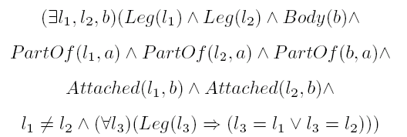
Physical composition
One object may be part of another:
  PartOf(Bucharest,Romania)
  PartOf(Romania,EasternEurope)
  PartOf(EasternEurope,Europe)
The PartOf predicate is transitive (and irreflexive), so we can infer that PartOf(Bucharest,Europe)
More generally:
  ∀ x PartOf(x,x)
  ∀ x,y,z PartOf(x,y) ∧ PartOf(y,z) ⇒ PartOf(x,z)
Categories of composite objects: often characterized by structural relations among parts.
  E.g. Biped(a) ⇒

Slide 14
Measurements
Objects have height, mass, cost, ....
Values that we assign to these are measures
Combine Unit functions with a number: Length(L₁) = Inches(1.5) = Centimeters(3.81).
Conversion between units:
∀ i Centimeters(2.54 x i)=Inches(i).
Some measures have no scale: Beauty, Difficulty, etc.
  Most important aspect of measures: is that they are orderable.
  Don't care about the actual numbers. (An apple can have deliciousness .9 or .1.)
Notes:
Unit function=单位函数

Slide 15
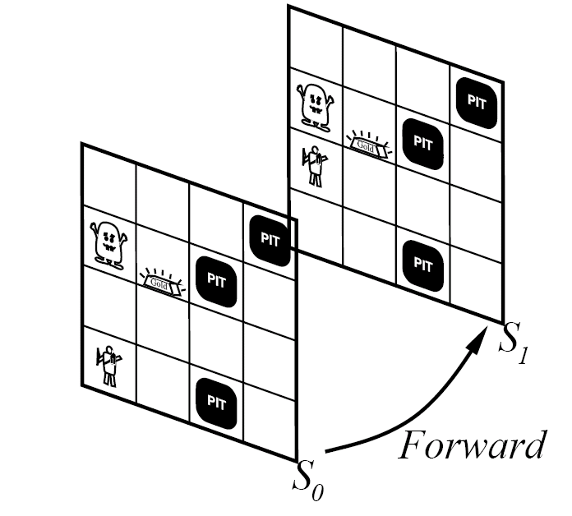
Actions, events and situations
Reasoning about outcome of actions is central to KB-agent.
How can we keep track of location in FOL?
  Remember the multiple copies in PL.
Representing time by situations (states resulting from the execution of actions).
  Situation calculus
Notes:
Situation calculus=状态演算

Slide 16
Actions, events and situations
Situation calculus(SC):
  Actions are logical terms
  Situations are logical terms consiting of
    The initial situation I
    All situations resulting from the action on I (=Result(a,s))
  Fluent are functions and predicates that vary from one situation to the next.
    E.g. ¬Holding(G₁, S₀)
  Eternal predicates are also allowed
    E.g. Gold(G₁)

Slide 17
Actions, events and situations
Results of action sequences are determined by the individual actions.
Projection task: an SC agent should be able to deduce the outcome of a sequence of actions.
Planning task: find a sequence that achieves a desirable effect

Slide 18
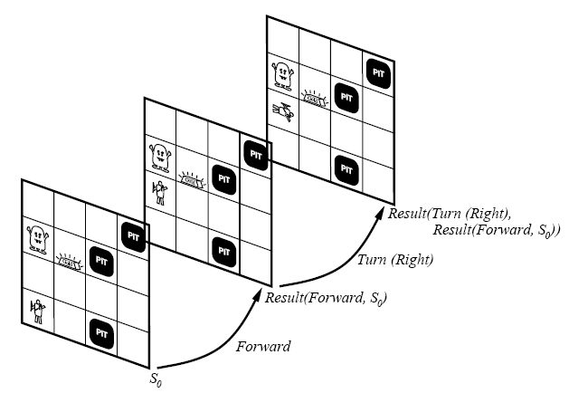
Actions, events and situations

Slide 19
Describing change
Simplest Situation calculus requires two axioms to describe change:
  Possibility axiom: when is it possible to do the action
    At(Agent,x,s) ∧ Adjacent(x,y) ⇒ Poss(Go(x,y),s)
  Effect axiom: describe changes due to action
    Poss(Go(x,y),s) ⇒ At(Agent,y,Result(Go(x,y),s))
What stays the same?
  Frame problem: how to represent all things that stay the same?
  Frame axiom: describe non-changes due to actions
    At(o,x,s) ∧ (o ≠ Agent) ∧ ¬Holding(o,s) ⇒ At(o,x,Result(Go(y,z),s))

Slide 20
Representational frame problem
If there are F fluents and A actions then we need AF frame axioms to describe other objects that are stationary unless they are held.
  We write down the effect of each actions
Solution: describe how each fluent changes over time
  Successor-state axiom:
    Pos(a,s) ⇒ (At(Agent,y,Result(a,s)) ⇔ (a = Go(x,y)) ∨
    (At(Agent,y,s) ∧ a ≠ Go(y,z))
  Note that next state is completely specified by current state.
  Each action effect is mentioned only once.

Slide 21
Other problems
How to deal with secondary (implicit) effects?
  If the agent is carrying the gold and the agent moves then the gold moves too.
  Ramification problem
How to decide EFFICIENTLY whether fluents hold in the future?
  Inferential frame problem.
Extensions:
  Event calculus (when actions have a duration)
  Process categories
Notes:
Ramification problem=分支问题

Slide 22
Mental events and objects
So far, KB agents can have beliefs and deduce new beliefs
What about knowledge about beliefs? What about knowledge about the inference process?
  Requires a model of the mental objects in someone’s head and the processes that manipulate these objects.
Relationships between agents and mental objects: believes, knows, wants, …
  Believes(Lois,Flies(Superman)) with Flies(Superman) being a function … a candidate for a mental object (reification).
  Agent can now reason about the beliefs of agents.
Notes:
Reification=具体化

Slide 23
The internet shopping world
A Knowledge Engineering example
An agent that helps a buyer to find product offered on the internet.
  IN = product description (precise or ¬precise)
  OUT = list of webpages that offer the product for sale.
Environment = WWW
Percepts = web pages (character strings)
  Extracting useful information required.

Slide 24
The internet shopping world
Find relevant product offers
    RelevantOffer(page,url,query) ⇔ Relevant(page, url, query) ∧ Offer(page)
  Write axioms to define Offer(x)
  Find relevant pages: Relevant(x,y,z) ?
    Start from an initial set of stores.
    What is a relevant category?
    What are relevant connected pages?
  Require rich category vocabulary.
    Synonymy and ambiguity
  How to retrieve pages: GetPage(url)?
    Procedural attachment
Compare offers (information extraction).

Slide 25
Reasoning systems for categories
How to organize and reason with categories?
  Semantic networks
    Visualize knowledge-base
    Efficient algorithms for category membership inference
  Description logics
    Formal language for constructing and combining category definitions
    Efficient algorithms to decide subset and superset relationships between categories.

Slide 26
Semantic Networks
Logic vs. semantic networks
Many variations
  All represent individual objects, categories of objects and relationships among objects.
Allows for inheritance reasoning
  Female persons inherit all properties from person.
Inference of inverse links
  SisterOf vs. HasSister

Slide 27
Semantic network example

Slide 28
Semantic networks
Drawbacks
  Links can only assert binary relations
  Can be resolved by reifying the proposition itself as an event belonging to an appropriate event category.
Representation of default values
  Enforced by the inheritance mechanism.

Slide 29
Description logics
Are designed to describe defintions and properties about categories
  A formalization of semantic networks
Principal inference task is
  Subsumption: checking if one category is the subset of another by comparing their definitions
  Classification: checking whether an object belongs to a category.
  Consistency: whether the category membership criteria are logically satisfiable.

Slide 30
Reasoning with Default Information
“The following courses are offered: CS101, CS102, CS106, EE101”
    Four (db)
      Assume that this information is complete (not asserted ground atomic sentences are false)
      = CLOSED WORLD ASSUMPTION
      Assume that distinct names refer to distinct objects
      = UNIQUE NAMES ASSUMPTION
    Between one and infinity (logic)
      Does not make these assumptions
      Requires completion.

Slide 31
Truth maintenance systems
Many of the inferences have default status rather than being absolutely certain
  Inferred facts can be wrong and need to be retracted = BELIEF REVISION.
  Assume KB contains sentence P and we want to execute TELL(KB, ¬P)
    To avoid contradiction: RETRACT(KB,P)
    But what about sentences inferred from P?
Truth maintenance systems are designed to handle these complications.

